Slide 1
Lecture 9 Red-Black Trees
Department of Computer Science
Hofstra University
Notes:
Left-leaning Red–Black Trees
http://citeseerx.ist.psu.edu/viewdoc/summary?doi=10.1.1.139.282
B-tree
https://www.geeksforgeeks.org/b-tree-set-1-introduction-2/

Slide 2
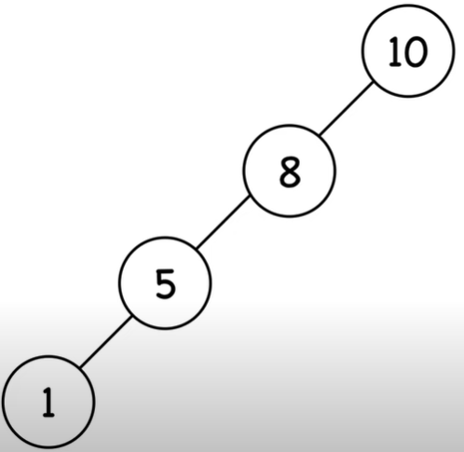
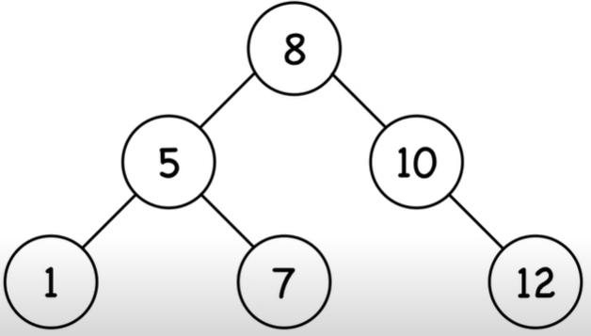
Binary Search Trees
Ordered, or sorted, binary trees.
Each node can have 2 subtrees.
Items to the left of a given node are smaller.
Items to the right of a given node are larger.
Balanced search trees have guaranteed height of O(log n) for n items
Red-Black Tree is a type of balanced search tree

Slide 3
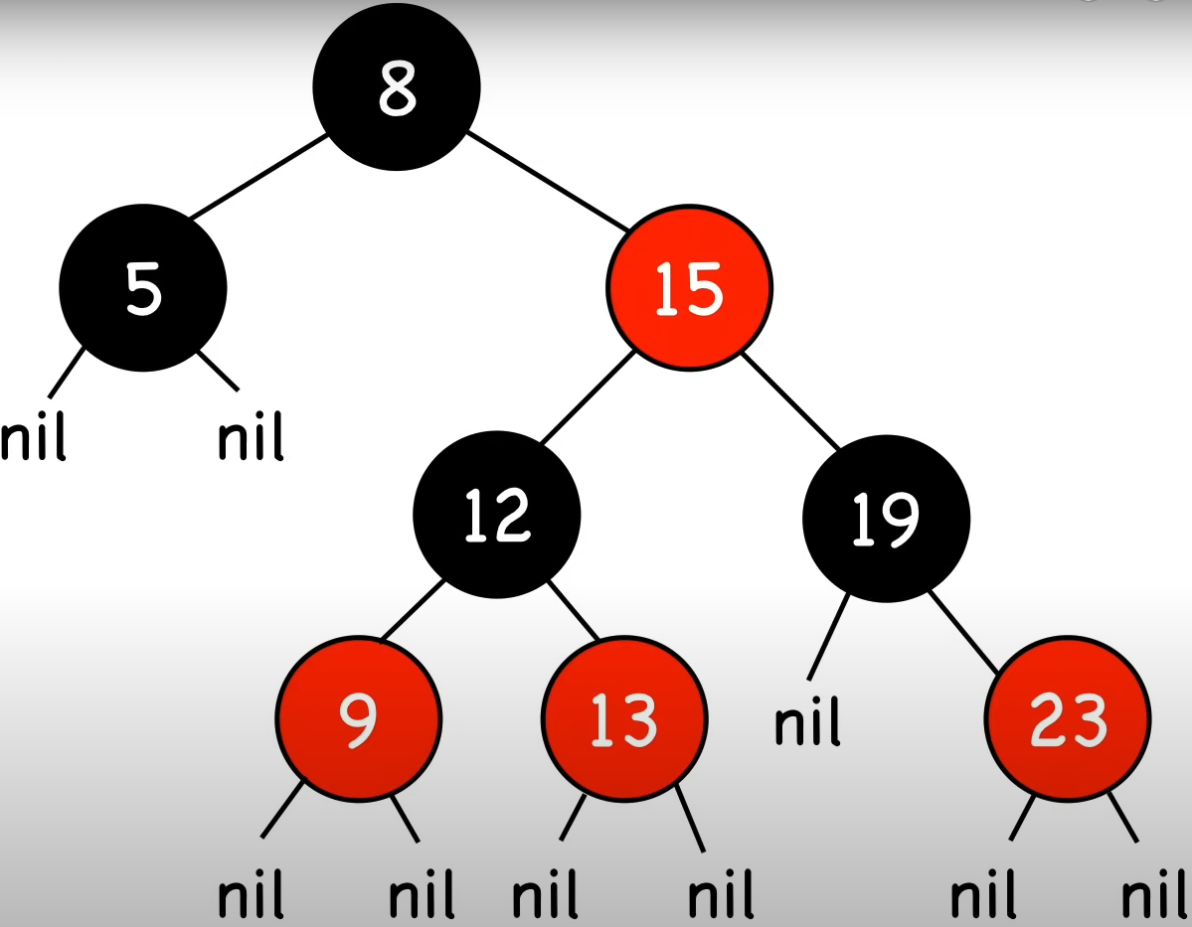
Red-Black Tree
1. Node Color: A node is either red or black.
2. Root Property: The root and leaves (NIL) are black.
3. Red Property: If a node is red, then its children are black.
4. Black Property: All paths from a node to its NIL descendants contain the same number of black nodes.
Path length excludes root node itself, so here each path contains 1 black node
Notes:
Nodes require one storage bit to keep track of color.
Node Color: Each node is either red or black.
Root Property: The root of the tree is always black.
Red Property: Red nodes cannot have red children (no two consecutive red nodes on any path).
Black Property: Every path from a node to its descendant null nodes (leaves) has the same number of black nodes.
Leaf Property: All leaves (NIL nodes) are black.

Slide 4
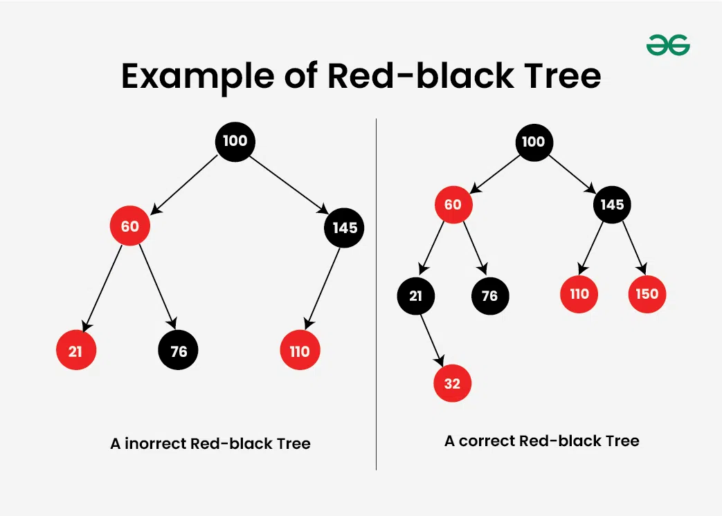
Example
Tree on the left: Incorrect Red Black Tree.
Two red nodes are adjacent to each other.
One of the paths to a leaf node has zero black nodes, whereas the other two paths contain 1 black node each.

Slide 5
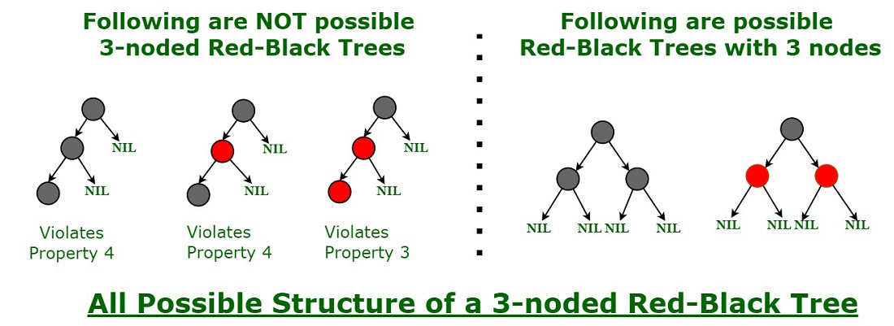
Red-Black tree ensures balancing
A chain of 3 nodes is not possible in a Red-Black tree

Slide 6
Additional Properties
Balanced search tree: the longest path (root to farthest NIL) is no more than twice the length of the shortest path (root to nearest NIL).
Shortest path: all black nodes (=2)
Longest path: alternating red and black (=4)
Operations: search, insert, remove, each with time complexity O(log(n)).
Insert and remove may result in violation of red-black tree properties, use rotations to fix it

Slide 7
Rotations
Before Rotation:
x
\
y
/ \
a b
After Left Rotation:
y
/ \
x b
\
a
Before Rotation:
x
/
y
/ \
a b
After Right Rotation:
y
/ \
a x
/
b
Alters the structure of a tree by rearranging subtrees
Goal is to decrease the height of the tree to maximum height of O(log n)
Larger subtrees up, smaller subtrees down
Does not affect the order of elements
Time complexity O(1)
Notes:
left-rotate & right-rotate red-black

Slide 8
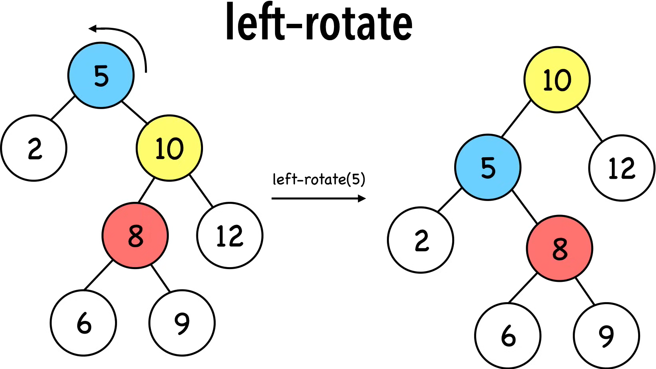
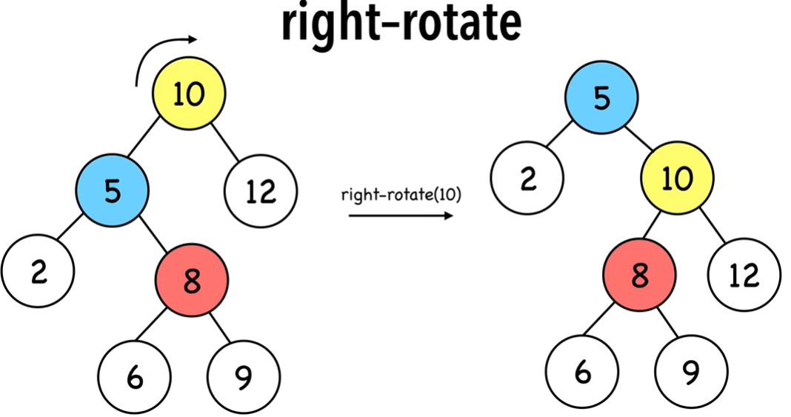
Rotations Examples

Slide 9
Insertion
Inserting a new node in a Red-Black Tree involves a two-step process: performing a standard binary search tree (BST) insertion, followed by fixing any violations of Red-Black properties.
Insertion Steps
BST Insert: Insert the new node into BST and color it red.
Fix Violations:
If the parent of the new node is black, no properties are violated.
If the parent is red, the tree might violate the Red Property, requiring fixes.

Slide 10
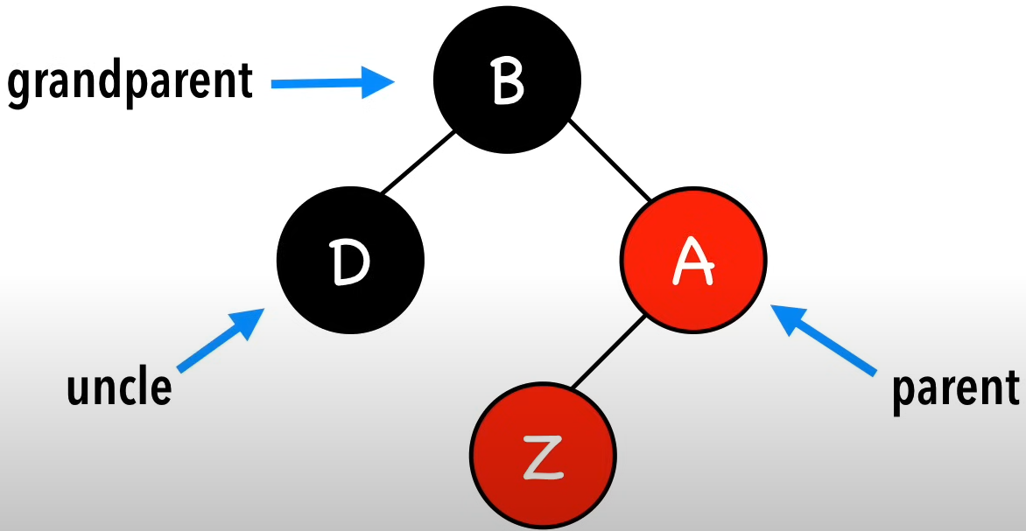
Insertions
Step 1. Insert Z and color it red
Step 2. Recolor and rotate nodes to fix violations
4 scenarios after inserting node Z
Case 0. Z = root
Color Z black
Case 1. Z.uncle = red
Recolor Z’s parents and grandparent
Case 2. Z.uncle = black (triangle)
Rotate Z.parent, turns into Case 3
Case 3. Z.uncle = black (line)
Rotate Z.grandparent & Recolor Z’s parents and grandparent
Notes:
v

Slide 11


Case 0. Z = root
Color Z black
Color Z
black

Slide 12
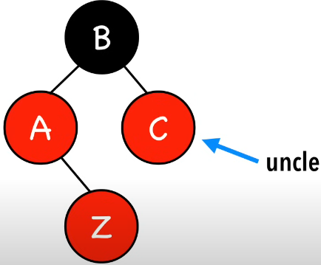
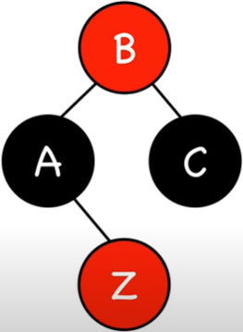
Case 1. Z.uncle = red
Recolor Z’s parents and grandparent
Recolor
Parents &
grandparents

Slide 13
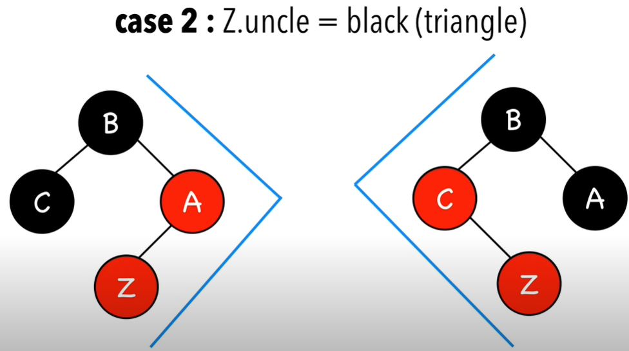
Case 2. Z.uncle = black (triangle)

Slide 14
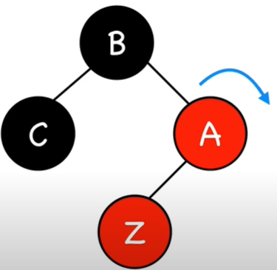
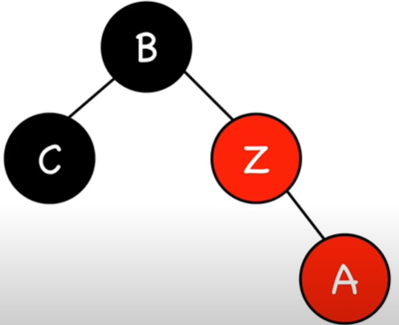
Case 2. Z.uncle = black (triangle)
Rotate Z.parent
Turns into Case 3
rotate
Z.parent

Slide 15
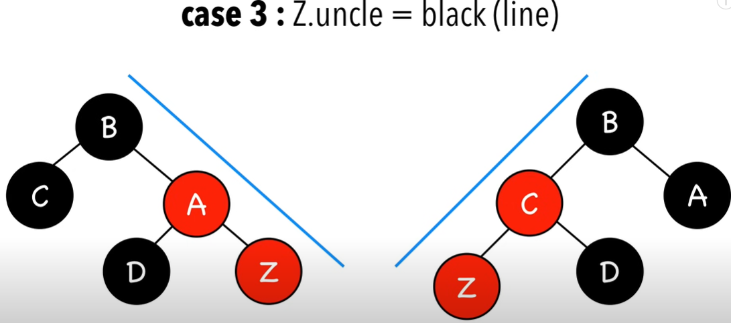
Case 3 Z.uncle = black (line)

Slide 16
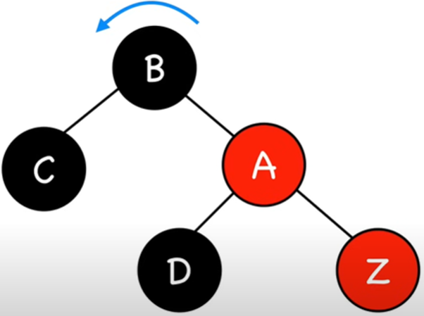
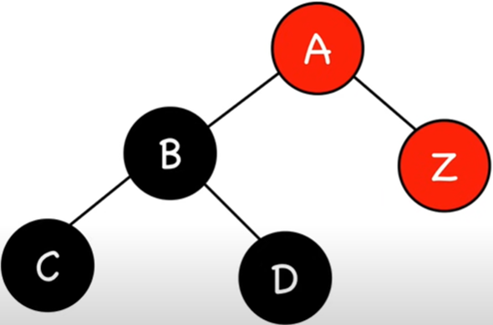
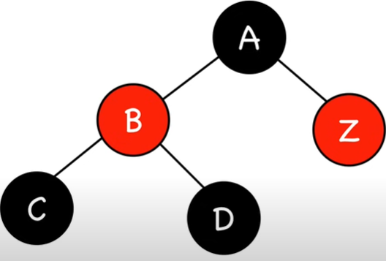
Case 3 Z.uncle = black (line)
Rotate Z.grandparent
rotate
Z.grandparent
recolor
Parents &
grandparents

Slide 17
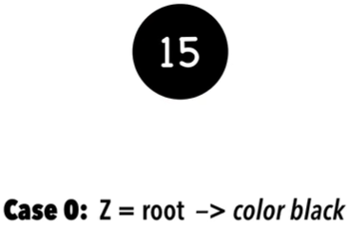
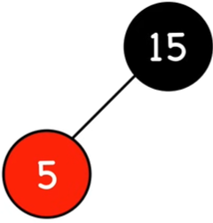
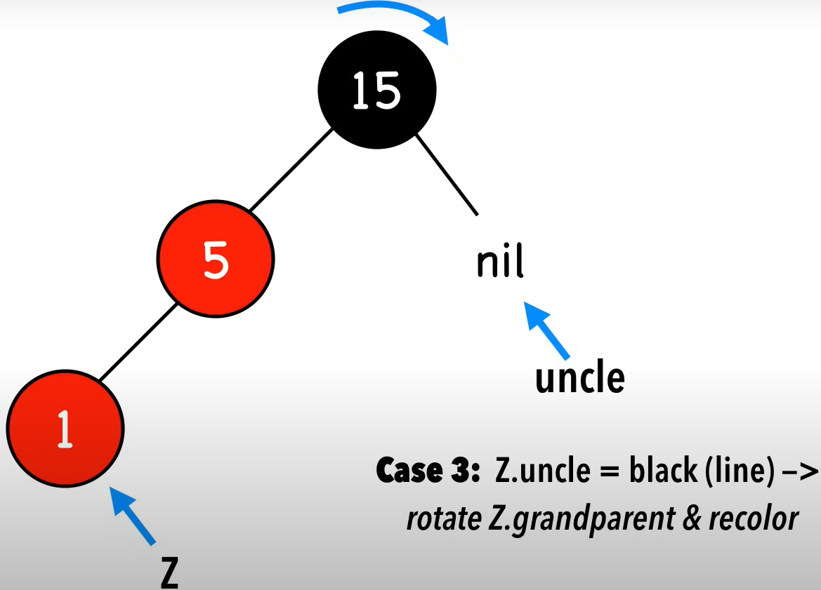
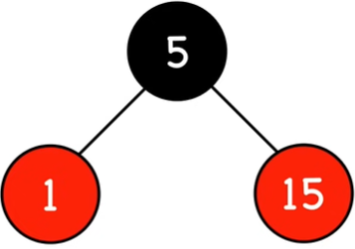
Example 1
insert 15
insert 5
insert 1

Slide 18
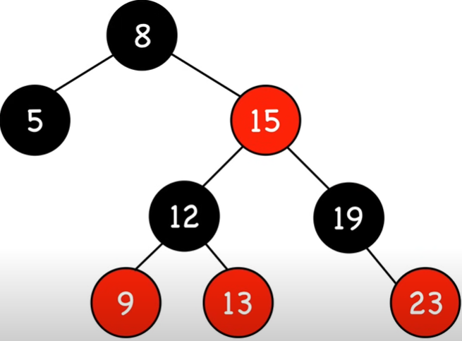
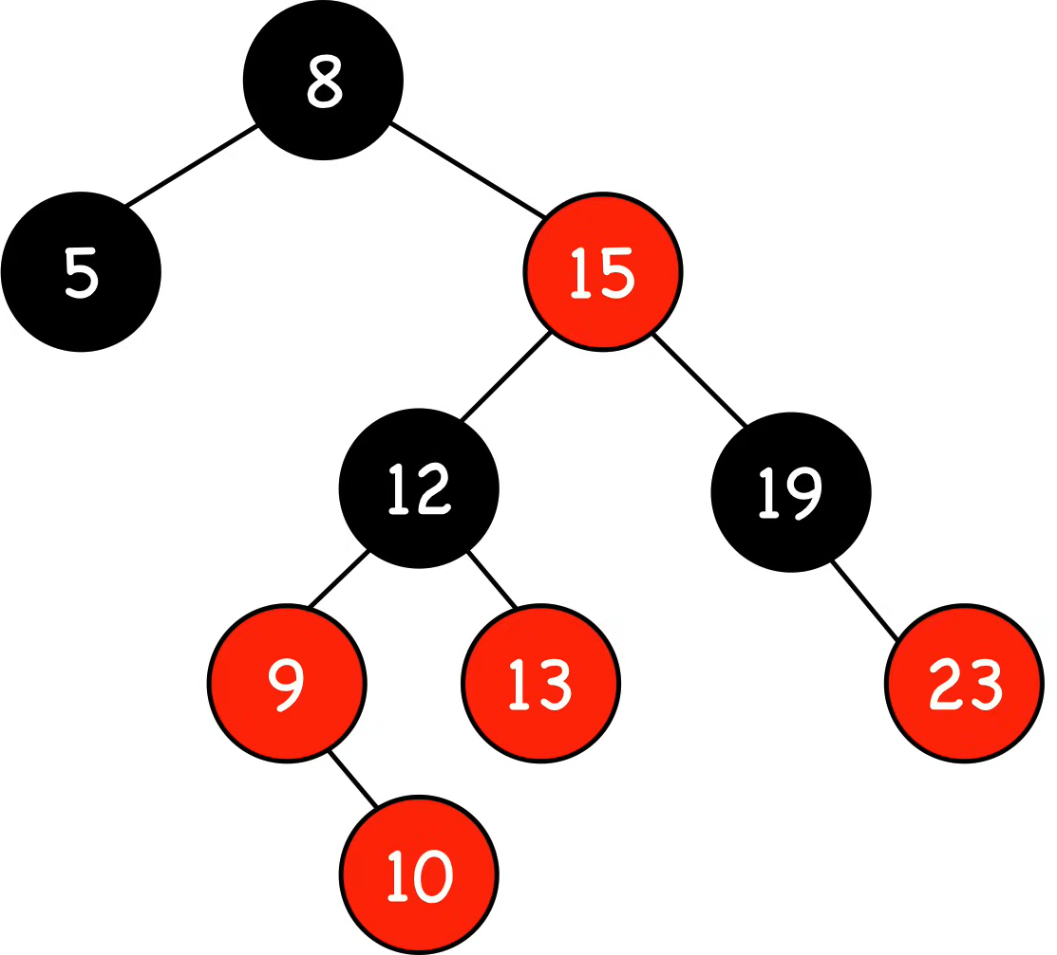
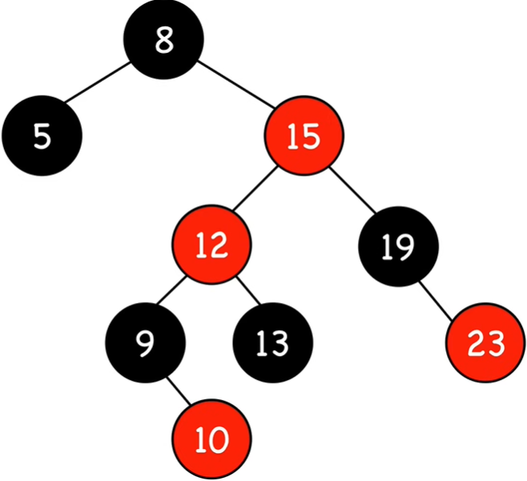
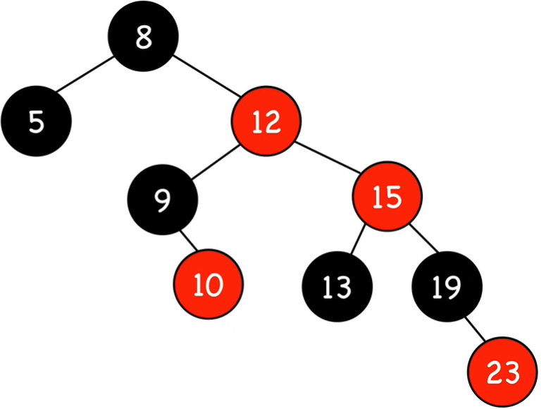
Example 2
insert 10
Z.uncle
Z
Case 2. Z.uncle = black
right rotate on 15
Z.uncle
Case 1. Z.uncle = red
recolor
Z.uncle
Z
Z

Slide 19
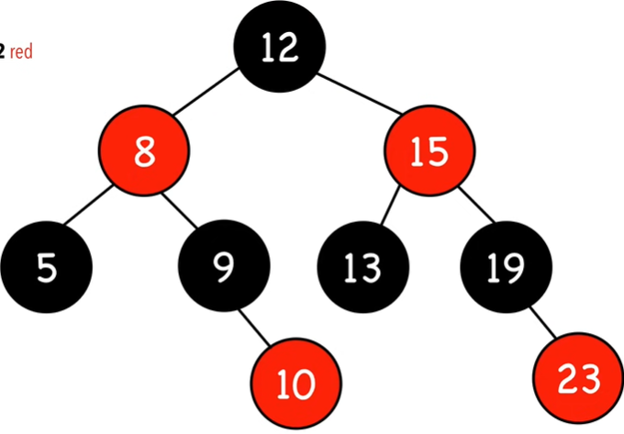
Example 2 Con’t
Case 2. Z.uncle = black
left rotate on 8 & recolor
Z.uncle
Z

Slide 20
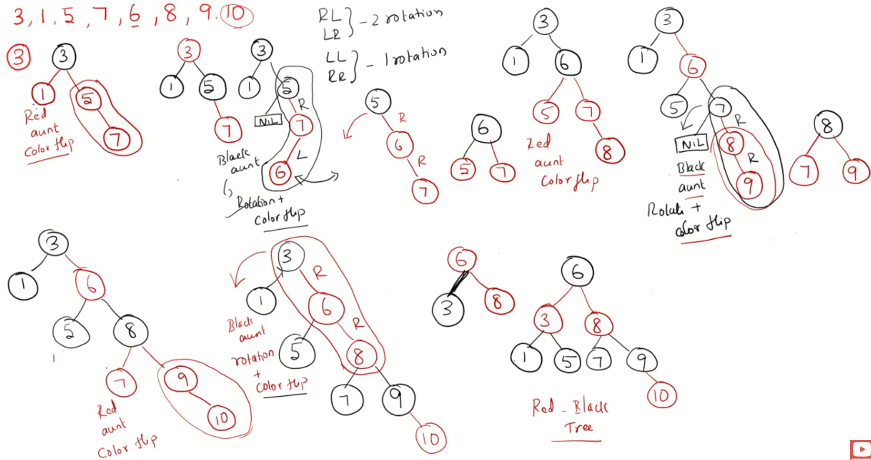
Another Example
Red Black Tree – Insertion
https://www.youtube.com/watch?v=9ubIKipLpRU

Slide 21
Time Complexity
1. Insert : O(log(n))
maximum height of red-black trees
2. Color red : O(1)
3. Fix violations :
Constant # of:
a. Recolor : O(1)
b. Rotation: O(1)
Overall time complexity: O(log(n))

Slide 22
Applications
Red–black trees are widely used as system symbol tables.
Java: java.util.TreeMap, java.util.TreeSet.
C++ STL: map, multimap, multiset.
Linux kernel: completely fair scheduler, linux/rbtree.h.
Emacs: conservative stack scanning.

Slide 23
Video Tutorials
Red-Black Trees // Michael Sambol
https://www.youtube.com/playlist?list=PL9xmBV_5YoZNqDI8qfOZgzbqahCUmUEin
Lecture slides based in this video series
Red Black Tree – Insertion
https://www.youtube.com/watch?v=9ubIKipLpRU
https://www.geeksforgeeks.org/introduction-to-red-black-tree/
https://www.geeksforgeeks.org/introduction-to-red-black-tree/

